Slide 1
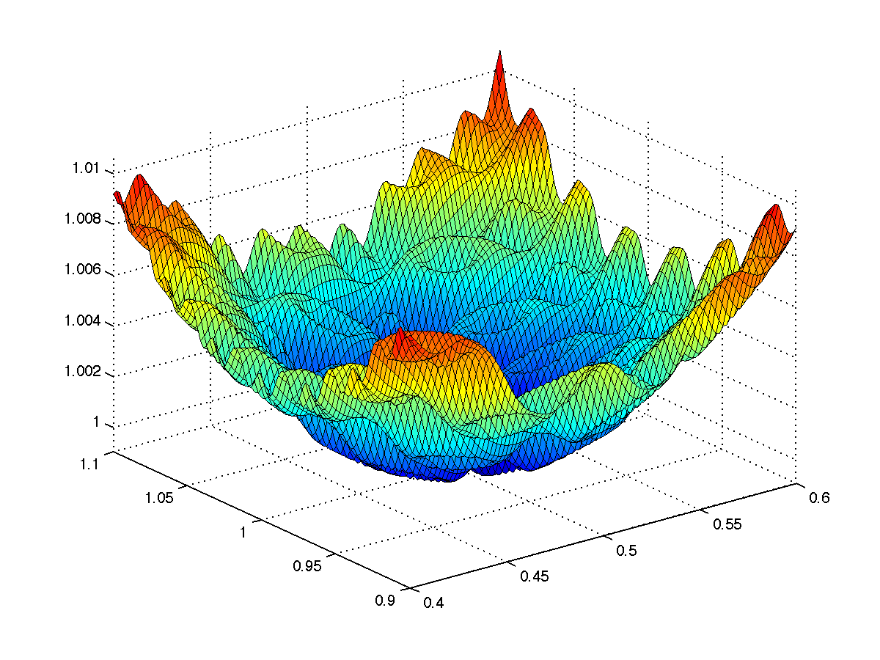

CS 5/7320 Artificial Intelligence Local Search AIMA Chapters 4.1 & 4.2
Slides by Michael Hahsler based on slides by Svetlana Lazepnik with figures from the AIMA textbook.
This work is licensed under a Creative Commons Attribution-ShareAlike 4.0 International License.

Slide 2

Recap: Uninformed Search/informed search
Tries to find the
best path
from a
given initial state
to a
given goal state.
Typically searches a large portion of the search space (needs time and memory).
Often comes with optimality guarantees.
Initial state
Goal state

Slide 3
Local search algorithms
Local move
Goal: A fast and memory-efficient way to find a good state. That means to search only a small portion of the search space.
We need an objective function over the states hat defines what “good” means → optimization problem.
x
x
x
Idea:
Formulate a solution as the state.
Improve the solution by moving to a neighboring state (i.e., search locally). This is fast and needs little memory (no search tree).

Slide 4
Local search algorithms
Difference to search from the previous chapter:
Often no explicit initial state.
Goal state is unknown and needs to be identified.
Path to goal and path cost are not important.
No search tree structure. Just stores the current state.
Use in AI
Utility-based agent: Use utility as the objective function and always move to higher utility states. A greedy method used for complicated/large state spaces or online search.
Goal-based agent: Identify a good goal state with a good objective function value before planning the path to that state.
General optimization: Use for effective heuristic search in large or continuous spaces (with an infinite state space).

Slide 5



Example: n-queens problem
Goal: Put n queens on an n × n board with no two queens on the same row, column, or diagonal.
State space: All possible n-queen configurations. How many are there?
What is a possible objective function?

Slide 6
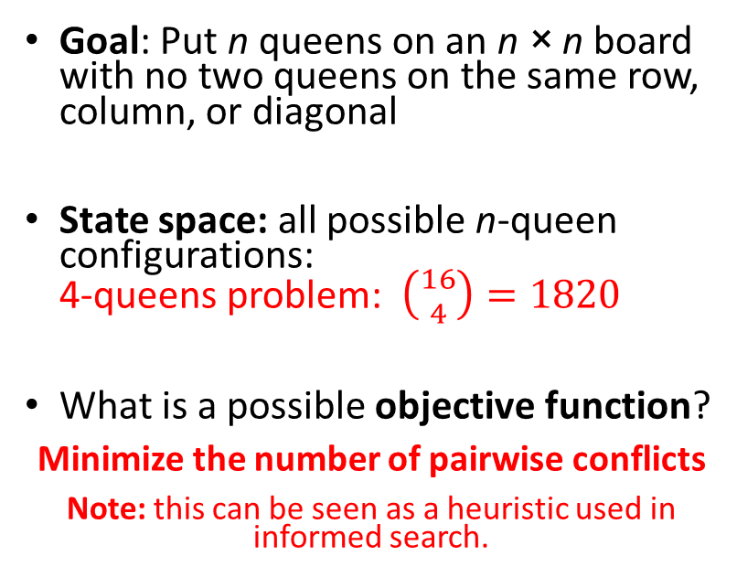
Example: n-queens problem
2 conflicts
Goal: Put n queens on an n × n board with no two queens on the same row, column, or diagonal
State space: all possible n-queen configurations: 4-queens problem: $\left({16 \atop 4}\right)=1820$
What is a possible objective function?
Minimize the number of pairwise conflicts
Note: this can be seen as a heuristic used in informed search.
0 conflicts

Slide 7
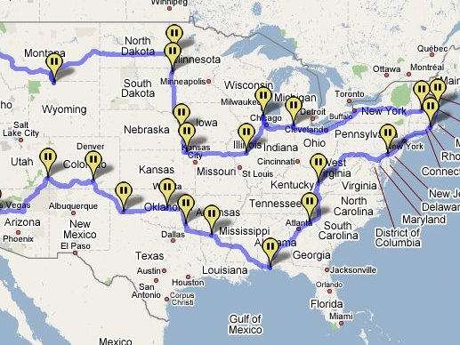
Example: Traveling salesman problem
Goal: Find the shortest tour connecting a given set of cities
State space: all possible tours (states are not individual cities!)
Objective function: minimize the length of the tour
Note: We have solved a different problem with uninformed/informed search! Each city was defined as a state and the path was the solution.

Slide 8
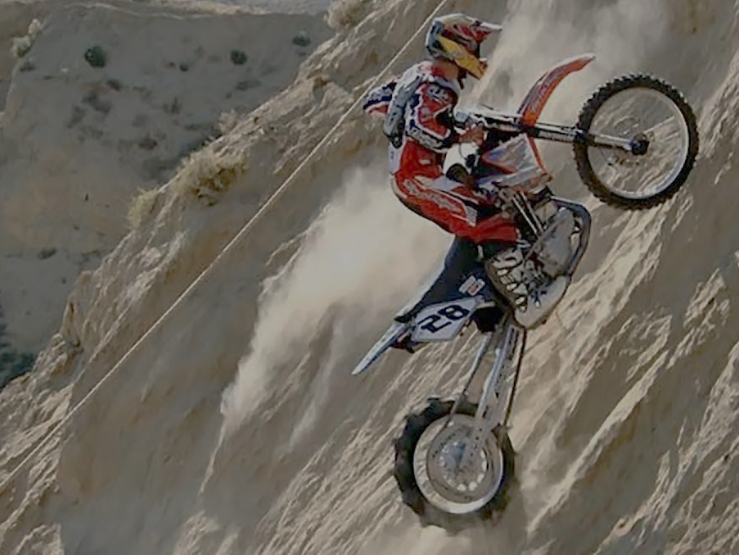
Hill-Climbing Search aka Greedy Local Search
Idea: keep a single “current” state and try to find better neighboring states.
MotorCycleUSA.com

Slide 9
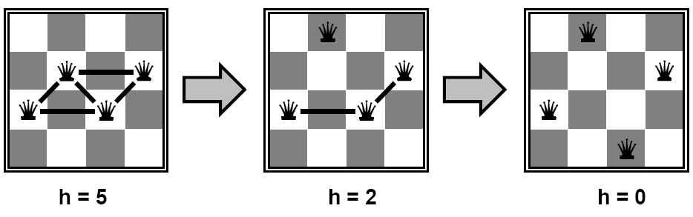
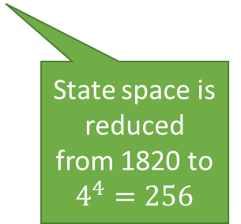
Example: n-queens problem
Goal: Put n queens on an n × n board with no two queens on the same row, column, or diagonal. State space: all possible n-queen configurations. We can restrict the state space: Only one queen per column.
Objective function: minimize the number of pairwise conflicts.
What is a possible local improvement strategy?
Move one queen within its column to reduce conflicts
State space is reduced from 1820 to $4^{4}=256$

Slide 10
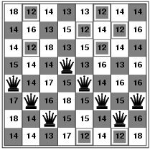
Example: n-queens problem
Goal: Put n queens on an n × n board with no two queens on the same row, column, or diagonal. State space: all possible n-queen configurations. We can restrict the state space: Only one queen per column.
Objective function: minimize the number of pairwise conflicts.
What is a possible local improvement strategy?
Move one queen within its column to reduce conflicts
h = 17
best local improvement has h = 12 Note that there are many options, and we have to choose one!

Slide 11

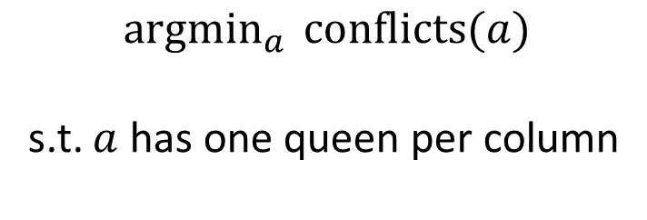
Example: n-queens problem
Optimization problem: find the best arrangement $a$
$${argmin}_{a } conflicts(a)$$ s.t. $a$ has one queen per column
This makes the problem easier.

Slide 12
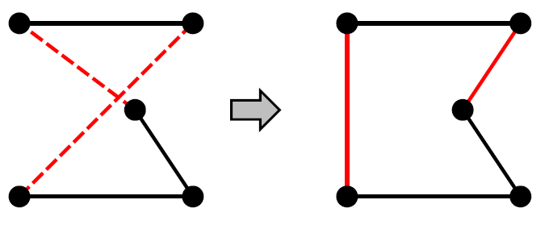
Example: Traveling Salesman Problem
Goal: Find the shortest tour connecting n cities
State space: all possible tours
Objective function: length of tour
What’s a possible local improvement strategy?
Start with any complete tour, perform pairwise exchanges.
Permutation:
ABDEC
ABCED
A
B
A
B
C
C
D
E
D
E

Slide 13

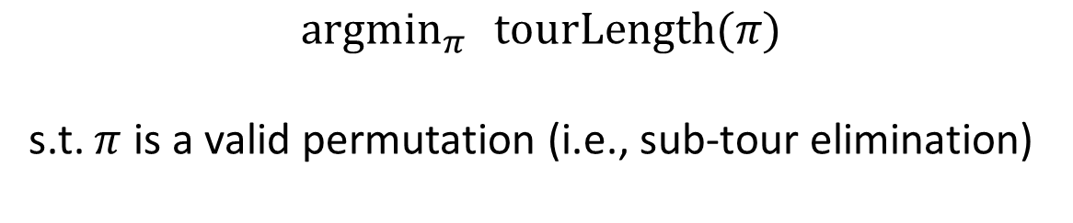
Example: Traveling Salesman Problem
Optimization problem: Find the best tour $π$
$${argmin}_{π } tourLength(π)$$ s.t. $π$ is a valid permutation (i.e., sub-tour elimination)
Permutation:
ABDEC
ABCED
A
B
A
B
C
C
D
E
D
E

Slide 14
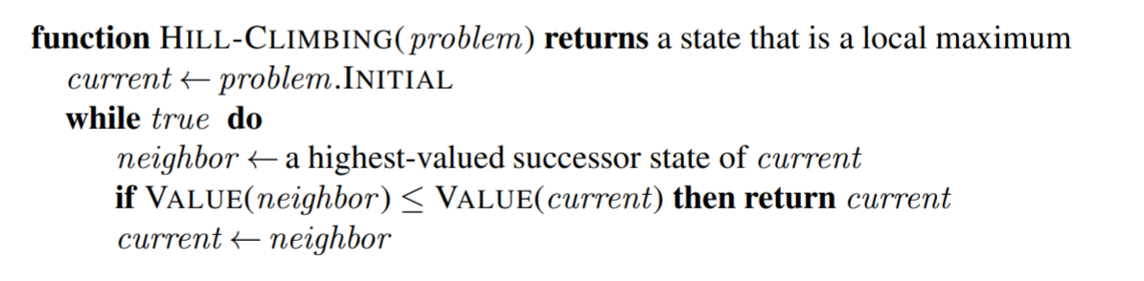
Hill-climbing search (= Greedy local search)
Many variants
Steepest-ascend hill climbing
Stochastic hill climbing
choose randomly among all uphill moves, or
generate randomly new states until a better one is found (first-choice hill climbing)
Random-restart hill climbing – to deal with local optima

Slide 15
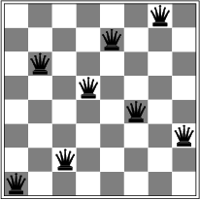
Hill-climbing search
Hill-climbing search is similar to a greedy best-first search without backtracking.
Is it complete/optimal?
No – can get stuck in local optima
Example: local optimum for the 8-queens problem. No single queen can be moved to improve the objective function.
h = 1

Slide 16
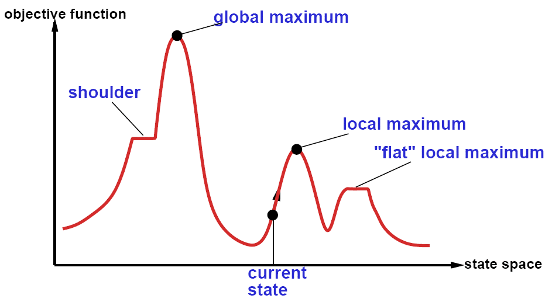
The state space “landscape”
Maximization problem
Neighbors placed next to each other
How to escape local maxima?
→ Random restart hill-climbing can help.
What about “shoulders” (“ridges” in higher dimensional space)?
What about “plateaux”?
→ Allow sideways moves.

Slide 17
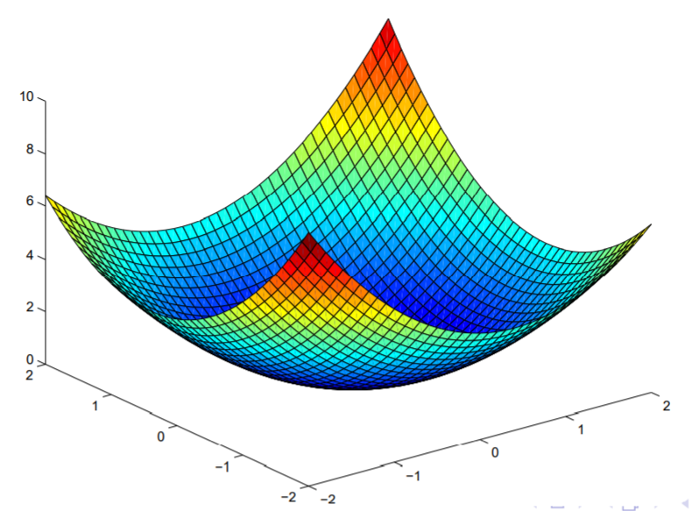
Non-convex/convex Optimization Problems
Minimization problem
Convex Problem
Non-convex Problem
One global optimum + smooth function → easy
Many local optima → hard
Many discrete optimization problems are like this.

Slide 18
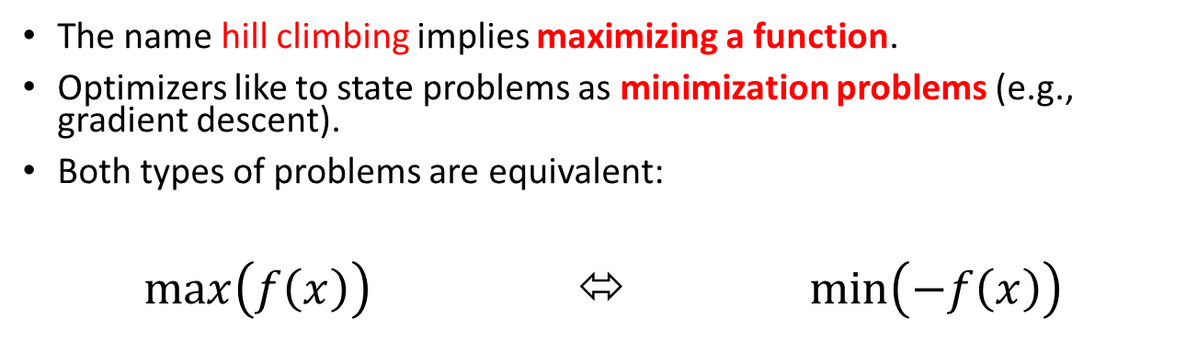
A Note on Minimization vs. Maximization
The name hill climbing implies maximizing a function.
Optimizers like to state problems as minimization problems (e.g., gradient descent).
Both types of problems are equivalent:
$\max\left(f\left(x\right)\right)$ ⬄ $\min\left(−f\left(x\right)\right)$

Slide 19
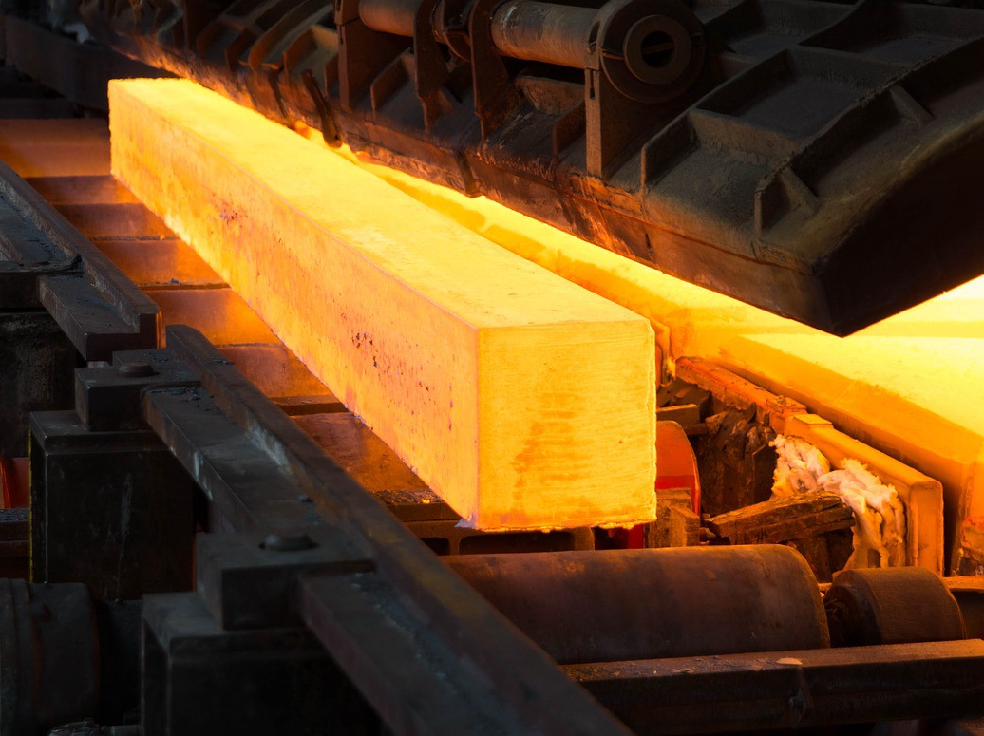
Simulated Annealing
Use heat to escape local optima…

Slide 20
Simulated annealing
Idea: First-choice stochastic hill climbing + escape local minima by allowing some “bad” moves but gradually decrease their frequency.
Inspired by the process of tempering or hardening metals by decreasing the temperature gradually.
“bad” local move
Objective function (minimize)
State space

Slide 21
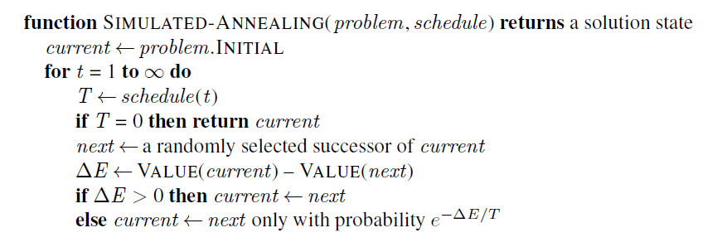
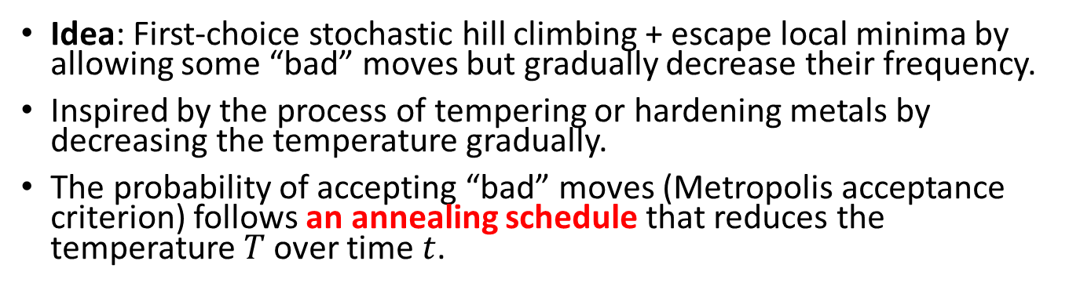
Simulated annealing
Idea: First-choice stochastic hill climbing + escape local minima by allowing some “bad” moves but gradually decrease their frequency.
Inspired by the process of tempering or hardening metals by decreasing the temperature gradually.
The probability of accepting “bad” moves (Metropolis acceptance criterion) follows an annealing schedule that reduces the temperature $T$ over time $t$.
Always do good moves
VALUE(next) – Value(current)
<
“bad” moves

Slide 22
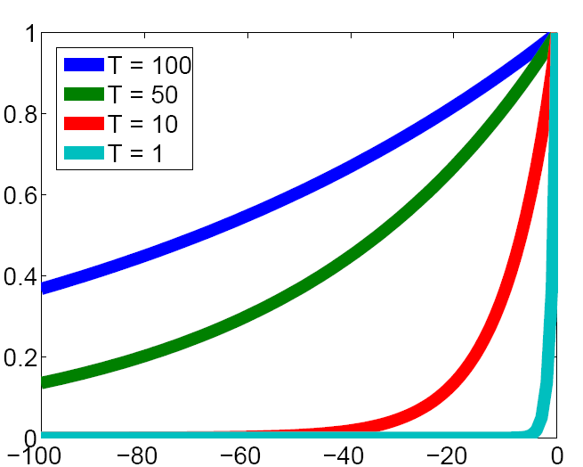
Effect of temperature
Prob. of accepting a worse state exp(Δ/T)
Δ
The lower the temperature, the less likely the algorithm will accept a worse state.

Slide 23
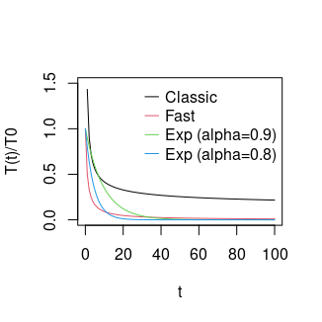
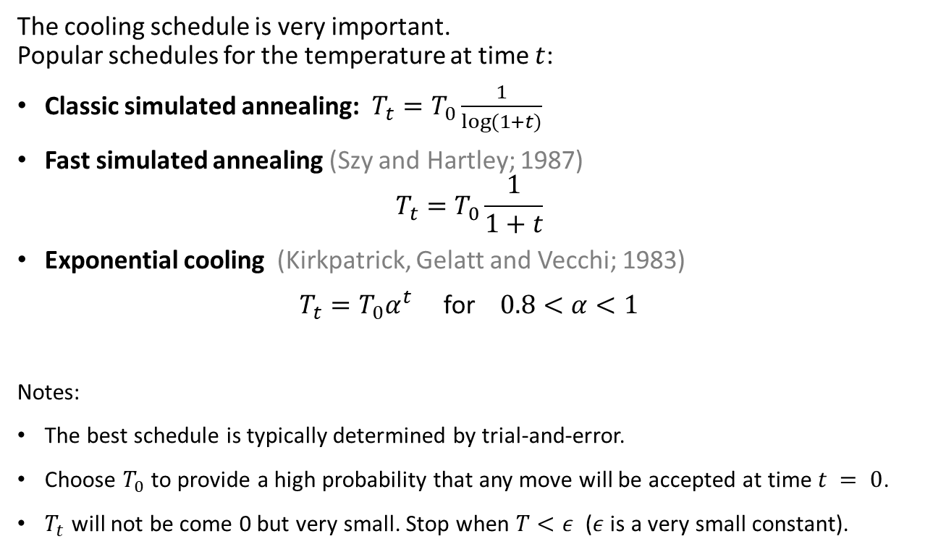
Cooling Schedule
The cooling schedule is very important. Popular schedules for the temperature at time $t$:
Classic simulated annealing: $T_{t}=T_{0}\frac{1}{log⁡(1+t)}$
Fast simulated annealing (Szy and Hartley; 1987)
$$T_{t}=T_{0}\frac{1}{1+t}$$
Exponential cooling (Kirkpatrick, Gelatt and Vecchi; 1983)
$T_{t}=T_{0}α^{t}$ for $0.8<α<1$
Notes:
The best schedule is typically determined by trial-and-error.
Choose $T_{0}$ to provide a high probability that any move will be accepted at time $t = 0$.
$T_{t}$ will not be come 0 but very small. Stop when $T<ε$ ($ε$ is a very small constant).

Slide 24
Simulated annealing search
Guarantee: If temperature decreases slowly enough, then simulated annealing search will find a global optimum with probability approaching one.
However:
This usually takes impractically long.
The more downhill steps you need to escape a local optimum, the less likely you are to make all of them in a row.
Markov Chain Monte Carlo (MCMC) is a general family of randomized algorithms for exploring complicated state spaces.

Slide 25
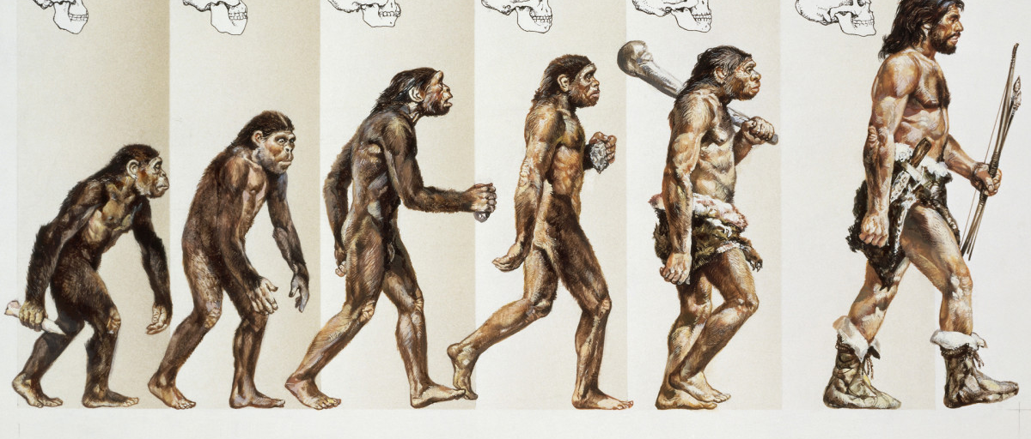
Evolutionary Algorithms
A Population-based Metaheuristics

Slide 26
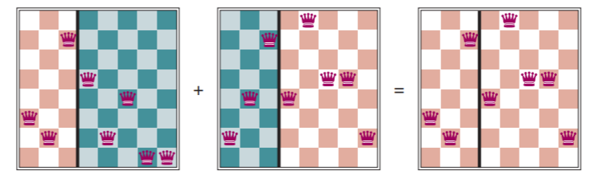
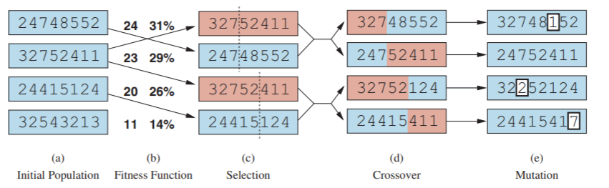
Evolutionary algorithms / Genetic Algorithms
A metaheuristic for population-based optimization.
Uses mechanisms inspired by biological evolution (genetics):
Reproduction: Random selection with probability based on a fitness function.
Random recombination (crossover)
Random mutation
Repeated for many generations
Example: 8-queens problem
8
7
6
5
4
3
2
1
Individual = state Encoding: row of the queen in each column
next generation

Slide 27
Search in Continuous Spaces

Slide 28
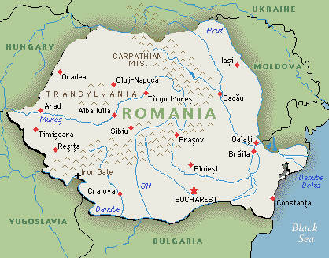
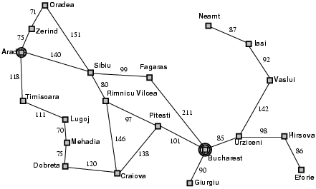

Discretization of the continuous space
Use atomic states to create a graph
Use a grid with spacing of size $δ$
Note: You probably need a way finer grid!
y
x

Slide 29
Discretization of the continuous space
How did we discretize this space?
Initial state
Goal state

Slide 30
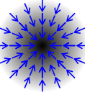
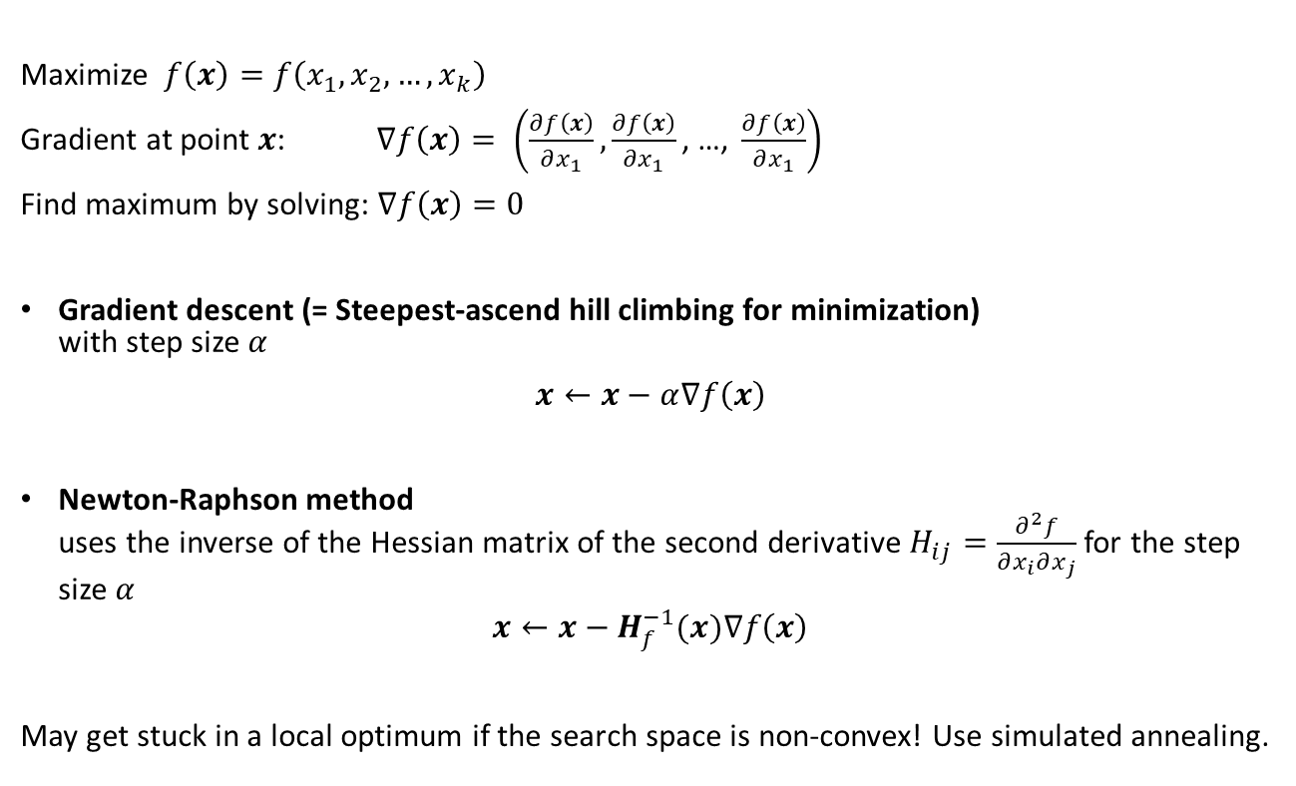
Search in continuous spaces: Gradient
Maximize $f\left(x\right)=f\left(x_{1},x_{2},…,x_{k}\right)$
Gradient at point $x$: $∇f\left(x\right)= \left(\frac{∂f\left(x\right)}{∂x_{1}}, \frac{∂f\left(x\right)}{∂x_{1}}\text{, …, }\frac{∂f\left(x\right)}{∂x_{1}}\right)$
Find maximum by solving: $∇f\left(x\right)=0$
Gradient descent (= Steepest-ascend hill climbing for minimization) with step size $α$
$x←x−α∇f\left(x\right)$
Newton-Raphson method uses the inverse of the Hessian matrix of the second derivative $H_{ij}=\frac{∂^{2}f}{∂x_{i}∂x_{j}}$ for the step size $α$
$$x←x−H_{f}^{−1}(x)∇f\left(x\right)$$
May get stuck in a local optimum if the search space is non-convex! Use simulated annealing.

Slide 31
Search in continuous spaces: Empirical Gradient Methods
What if the mathematical formulation of the objective function is not known?
We may have objective values at fixed points, called the training data.
In this case we can use empirical gradient search. This is related to steepest ascend hill climbing in the discretized state space.
→ We will talk more about search in continuous spaces with loss functions using gradient descend when we talk about parameter learning for machine learning.

